Slide 1
Project of Data Analysis
Lydia Kexin Zilong

Slide 2
Contents
1. Background Infomation
3. Multivariate Series
2. Univariate Series
3-1 Cross Correlations of Multivariate Series
2-1 Serial Correlation of Returns
2-2 Serial Correlation of Squared Returns
3-2 Cross Correlations of the Absolute Returns
2-3 Zero Mean Test
2-4 Volatility Variation
3-3 Variation of Correlations between Series
2-5 Returns Analysis
2-6 Correlation Between Variance and Returns
3-4 Coincidence of Extreme Returns
2-7 Skewness
2-8 Volatility Clustering
4. Problems and Reflections

Slide 3
1
Background of stocks and index
1-1 S&P 500
1-2 JNJ.N
1-3 PFE.N

Slide 4
1-1 S&P 500
Containing 500 stocks in US stock market.
One of the most authoritative index of US market, even in the world.
The chosen stocks would be changed if they are not good or representative.
This index can reflect the whole economic situation of US.
· We can see S&P500 has increased a lot steadily in last 10 years with two drops in Covid 19 period and 2022
· In last 10 years, the index increased by almost 2 times of its value in 2012.

Slide 5
1-2 JNJ.N
One of the the most comprehensive and powerful medical company in the world.
Containing various kinds of products, including care products, medicine, vaccine and medical
equipment.
Ranking 107 in the Fortune 500 in 2022.
· We can see that the JNJ.N has increased a lot steadily in last 10 years with a drop and a quick rebound in Covid 19 period.
· In last 10 years, the stock increased by almost 1.5 times of its value in 2012.

Slide 6
1-3 PFE.N
A basic, innovative medical company which focuses on its patients.
The vaccine of Covid-19 made by PFE.N is very famous in the world.
Ranking 1 in the medical companies in 2022.
· We can see that PFE.N dropped during 2020 because of the pandemic and increased a lot during 2021
because the vaccine were made.
· In last 10 years, the stock increased by almost 1 time of its value in 2012.

Slide 7
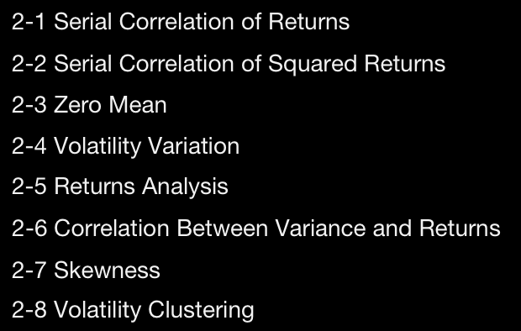
2
Univariate Series

Slide 8
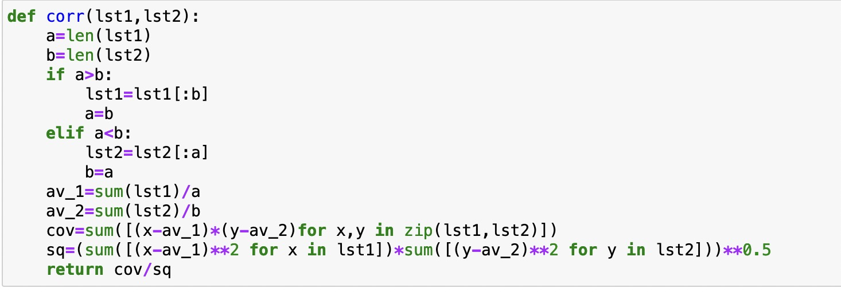
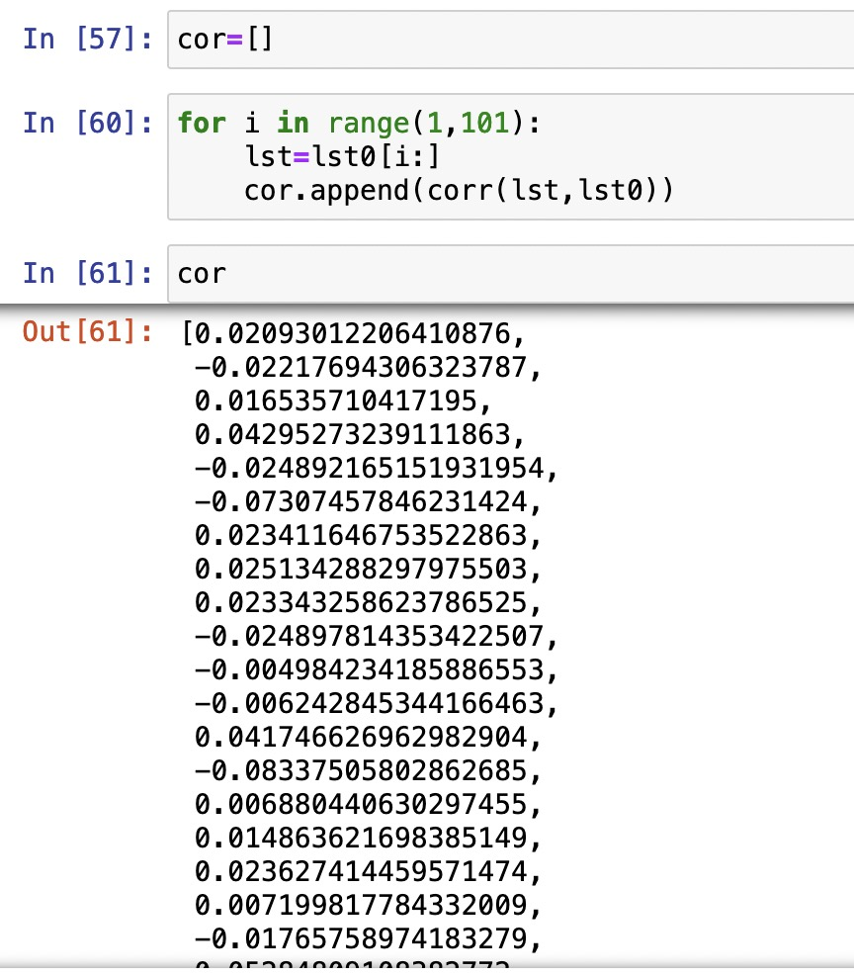
2-1 Serial Correlation
Fact : Return series are not independent and identically distributed (iid), although they show little serial correlation.
Corr(Rt,Rt−τ)≈0, τ =1,...100
Output
Result
in Python
Defining a corr function in Python

Slide 9
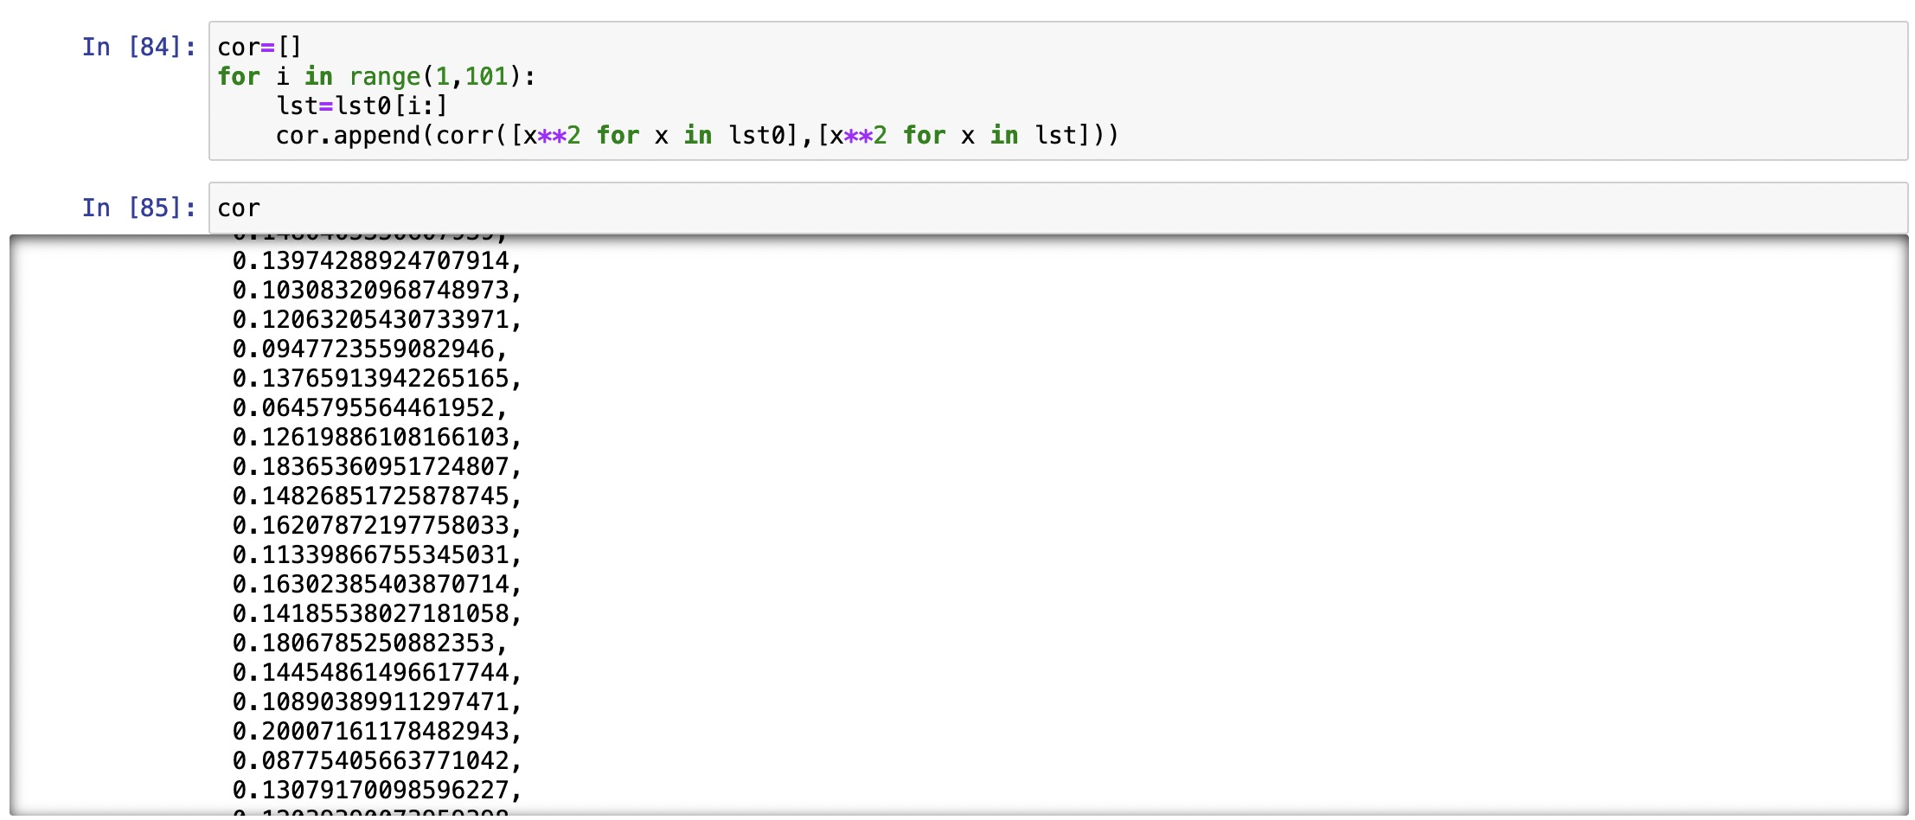
2-2 Serial Correlation of Squared Returns
Fact : Series of absolute or squared returns show profound serial correlation.

Slide 10
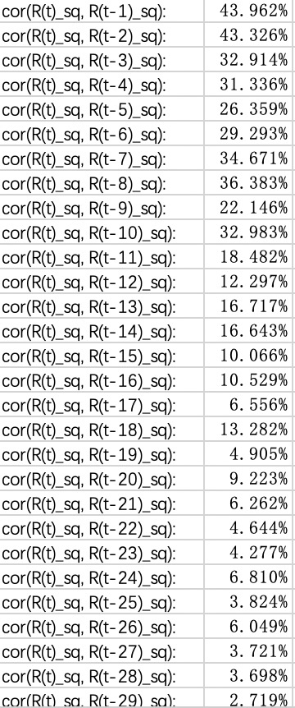
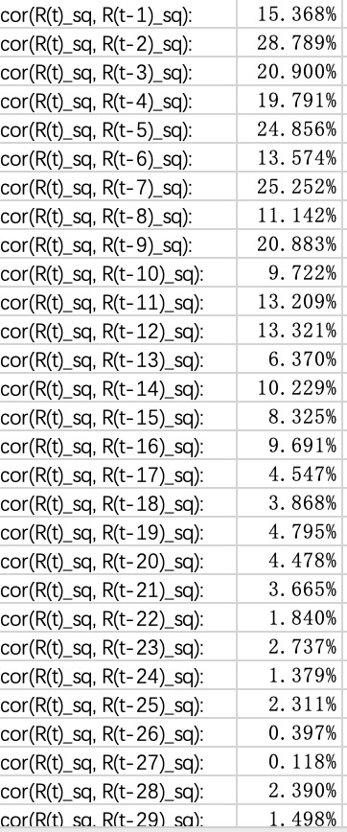
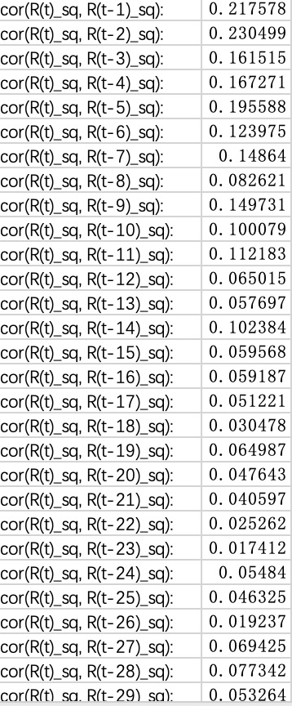
2-2 Serial Correlation of Squared Returns
Results
S&P 500
JNJ.N
PFE.N

Slide 11

2-3 Zero Mean Test
Fact : The standard deviation of returns completely dominates the mean of returns at short horizons: it is impossible to reject statistically zero mean
Testing Process:
· Using the data to calculate the mean and standard deviation.
· Using the mean and std to produce a normal distribution.
· Finding the 95% confidential range of the normal distribution.
· Calculating the 2.5% and 97.5% percentile of the distribution.
· Finding that 0 is in the range.

Slide 12
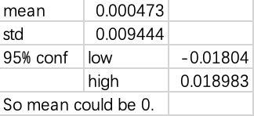
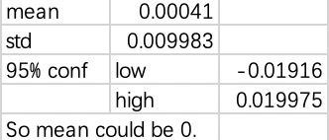
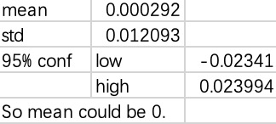
2-3 Zero Mean Test
S&P 500
JNJ.N
PFE.N
Conclusion
The standard deviation of returns completely dominates the mean of returns at short horizons: It is impossible to reject statistically zero mean

Slide 13

2-4 Returns Analysis
S&P 500
J&J
PFE
 | S&P | JNJ | PFE
kurtosis | 16.8545339 | 13.1018243 | 7.5935781
Conclusion: All are Platykurtic
(Heavy Tail)

Slide 14
2-5 Volatility Variation

Slide 15
2-5 Volatility Variation

Slide 16
2-5 Volatility Variation

Slide 17
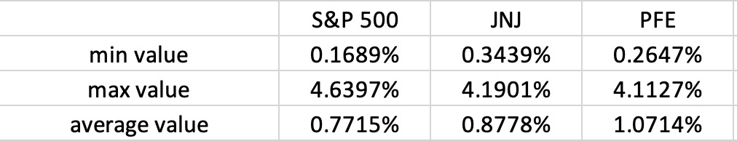
2-5 Volatility Analysis
Analysis :
S&P 500 is less volatile than JNJ and PFE ;
PFE is the most volatile stock

Slide 18
2-6 & 2-7 Return Analysis
 | S&P | JNJ | PFE
Correlation [return and var] | 1.740% | -3.517% | -5.287%
 | S&P | JNJ | PFE
skew | -0.2696 | -0.4777 | 0.3154
2-6 Correlation between Variance and Returns
JNJ and PFE display negative correlation between
variance and returns
S&P 500 displays positive correlation between
variance and returns
2-7 Skewness
Two distributions of the three stocks are negatively skewed

Slide 19
2-8 Volatility Clustering--Process
05
Probability Matrix
The probability staying the initial label
04
Last Label
01
Initial choice of centers
Repeat step 2 and 3 until the cetners become stable (equal to last round clustering centers)
Equidistant points
03
Re-choose centers
50 percentile of each cluster
02
First label
Cluster all the data points into the centers based on absolute distance value

Slide 20
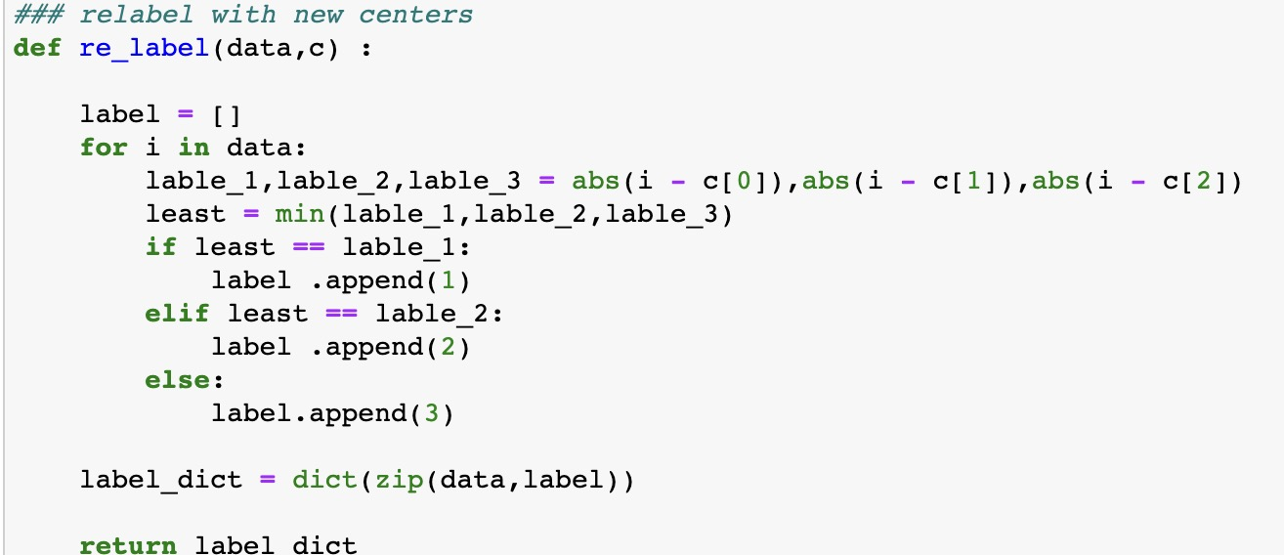
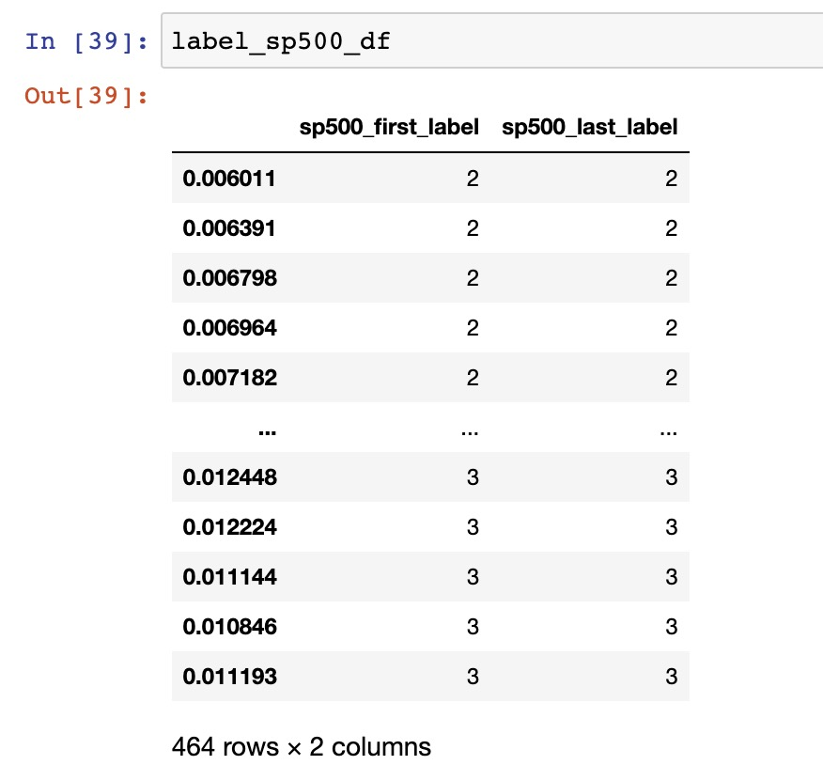
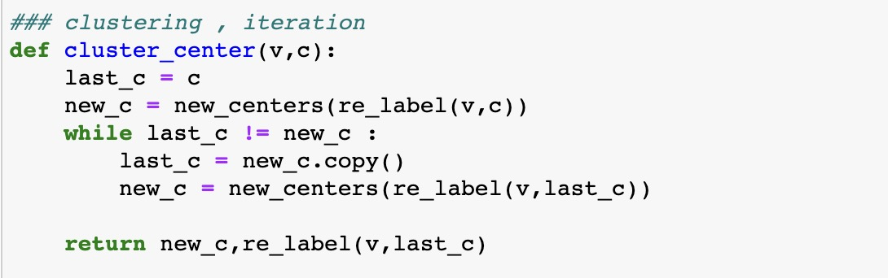
2-8 Volatility Clustering--Python
Label process
Example of the outcomes
Check the stable state

Slide 21
2-8 Volatility Clustering

Slide 22
2-5 Volatility Variation

Slide 23
2-8 Volatility Clustering--Probablity Matrix（Wrong）
S&P 500
J&J
PFE
(first,last) | 1 | 2 | 3
1 | 100.000% | 0.000% | 0.000%
2 | 42.767% | 57.233% | 0.000%
3 | 0.000% | 32.927% | 67.073%
(first,last) | 1 | 2 | 3
1 | 100.000% | 0.000% | 0.000%
2 | 45.890% | 54.110% | 0.000%
3 | 0.000% | 67.526% | 32.474%
(first,last) | 1 | 2 | 3
1 | 100.000% | 0.000% | 0.000%
2 | 5.946% | 94.054% | 0.000%
3 | 0.000% | 20.809% | 79.191%
S&P 500 (<3%)
J&J (<3%)
PFE (<3%)
(first,last) | 1 | 2 | 3
1 | 100.000% | 0.000% | 0.000%
2 | 42.675% | 57.325% | 0.000%
3 | 0.000% | 30.539% | 69.461%
(first,last) | 1 | 2 | 3
1 | 100.000% | 0.000% | 0.000%
2 | 27.211% | 72.789% | 0.000%
3 | 0.000% | 31.053% | 68.947%
(first,last) | 1 | 2 | 3
1 | 100.000% | 0.000% | 0.000%
2 | 7.222% | 92.778% | 0.000%
3 | 0.000% | 23.494% | 76.506%
S&P 500 (4 groups)
J&J (4 groups)
PFE (4 groups)
(first,last) | 1 | 2 | 3 | 4
1 | 100.00% | 0.00% | 0.00% | 0.00%
2 | 56.20% | 43.80% | 0.00% | 0.00%
3 | 0.00% | 66.67% | 33.33% | 0.00%
4 | 0.00% | 0.00% | 47.27% | 52.73%
(first,last) | 1 | 2 | 3 | 4
1 | 100.00% | 0.00% | 0.00% | 0.00%
2 | 0.79% | 99.21% | 0.00% | 0.00%
3 | 0.00% | 25.00% | 75.00% | 0.00%
4 | 0.00% | 0.00% | 44.86% | 55.14%
(first,last) | 1 | 2 | 3 | 4
1 | 100.00% | 0.00% | 0.00% | 0.00%
2 | 12.69% | 87.31% | 0.00% | 0.00%
3 | 0.00% | 71.43% | 28.57% | 0.00%
4 | 0.00% | 0.00% | 56.80% | 43.20%

Slide 24
2-8 Volatility Clustering--Error Analysis
After Correction
P_{n,m} = i / j
i : the number of data whose last label is n , and the data after has a last label of m
j : the number of data whose last label is n
Initial Wrong Idea
P_{n,m} = i / j
i : the number of data whose last label is m
j : the number of data whose first label is n
We create powerpoint templates based on new visual trend that’s fresh, relevant and always on the cutting edge.

Slide 25
2-8 Volatility Clustering--Probablity Matrix（Corrected）
S&P 500
J&J
PFE
(i,i+1) | 1 | 2 | 3
1 | 87.20% | 12.32% | 0.47%
2 | 17.24% | 73.79% | 8.97%
3 | 1.83% | 10.09% | 88.07%
(i,i+1) | 1 | 2 | 3
1 | 85.84% | 13.72% | 0.44%
2 | 14.35% | 79.90% | 5.74%
3 | 1.59% | 19.05% | 79.37%
(i,i+1) | 1 | 2 | 3
1 | 80.263% | 18.421% | 1.316%
2 | 13.876% | 77.990% | 8.134%
3 | 0.000% | 13.869% | 86.131%
S&P 500 (<3%)
J&J (<3%)
PFE (<3%)
(i,i+1) | 1 | 2 | 3
1 | 85.99% | 12.56% | 1.45%
2 | 19.86% | 72.34% | 7.80%
3 | 0.87% | 10.43% | 88.70%
(i,i+1) | 1 | 2 | 3
1 | 83.417% | 15.075% | 1.508%
2 | 19.394% | 67.879% | 12.727%
3 | 0.000% | 18.321% | 81.679%
(i,i+1) | 1 | 2 | 3
1 | 82.803% | 15.287% | 1.911%
2 | 12.683% | 81.463% | 5.854%
3 | 0.000% | 11.811% | 11.811%
S&P 500 (4 groups)
J&J (4 groups)
PFE (4 groups)
(i,i+1) | 1 | 2 | 3 | 4
1 | 83.89% | 13.33% | 2.78% | 0.00%
2 | 20.74% | 71.11% | 7.41% | 0.74%
3 | 1.08% | 15.05% | 72.04% | 10.75%
4 | 0.00% | 0.00% | 18.97% | 81.03%
(i,i+1) | 1 | 2 | 3 | 4
1 | 73.11% | 22.69% | 4.20% | 0.00%
2 | 19.14% | 63.58% | 15.43% | 1.23%
3 | 0.00% | 20.13% | 74.21% | 5.66%
4 | 0.00% | 0.00% | 18.64% | 81.36%
(i,i+1) | 1 | 2 | 3 | 4
1 | 82.07% | 15.86% | 2.07% | 0.00%
2 | 12.69% | 79.70% | 5.58% | 1.52%
3 | 0.00% | 14.56% | 76.70% | 8.74%
4 | 0.00% | 3.70% | 18.52% | 77.78%

Slide 26
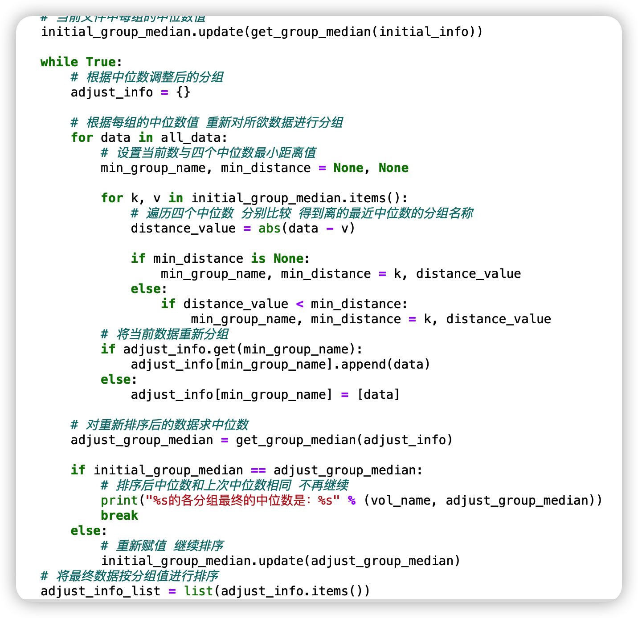
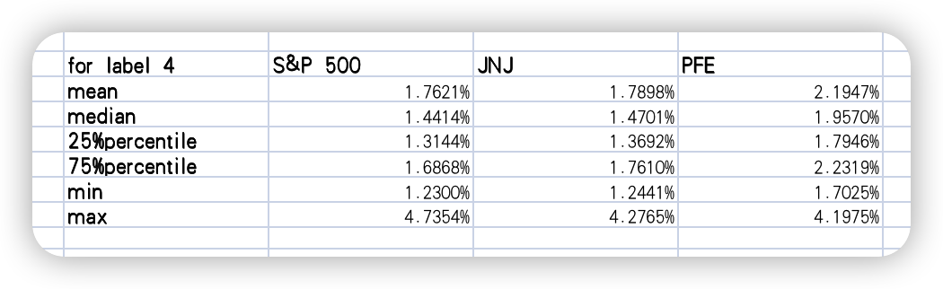
2-8 Volatility Clustering--4 Groups
Relabeling with Python
To check whether clustering with 4 groups is reasonable
The group of Label 4 contains volatility from about 1.2% to about 4%, which contains plenty of normal value of volatility,
contradicting with the expectation that the group 4 contains
only the outliers of the volatility.

Slide 27
3
Multivariate Series
3-1 Cross Correlations of Multivariate Series
3-2 Cross Correlations of the Absolute Returns
3-3 Variation of Correlations between Series
3-4 Coincidence of Extreme Returns

Slide 28
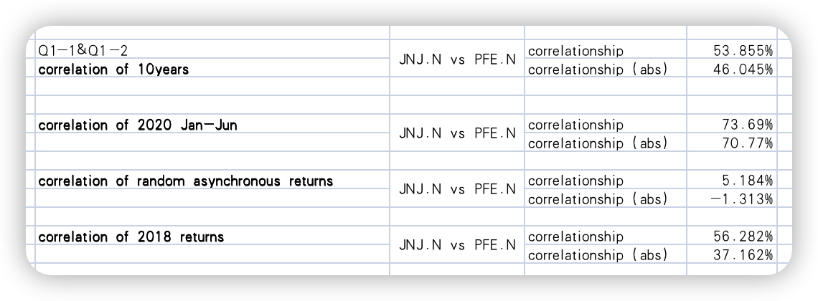
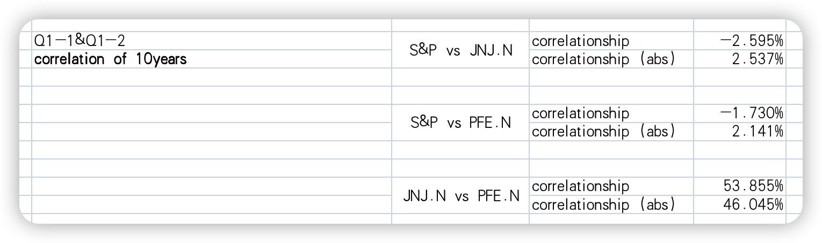
3-1&2 Cross Correlation
Conclusion
The return on the same date will be
more correlated
? ABS returns are not stronger correlated

Slide 29

3-3 Variation of Cross Correlation
Window:100
n=10
It is obvious that the cross correlation is constantly changing

Slide 30
3-4 Coincidence

Slide 31
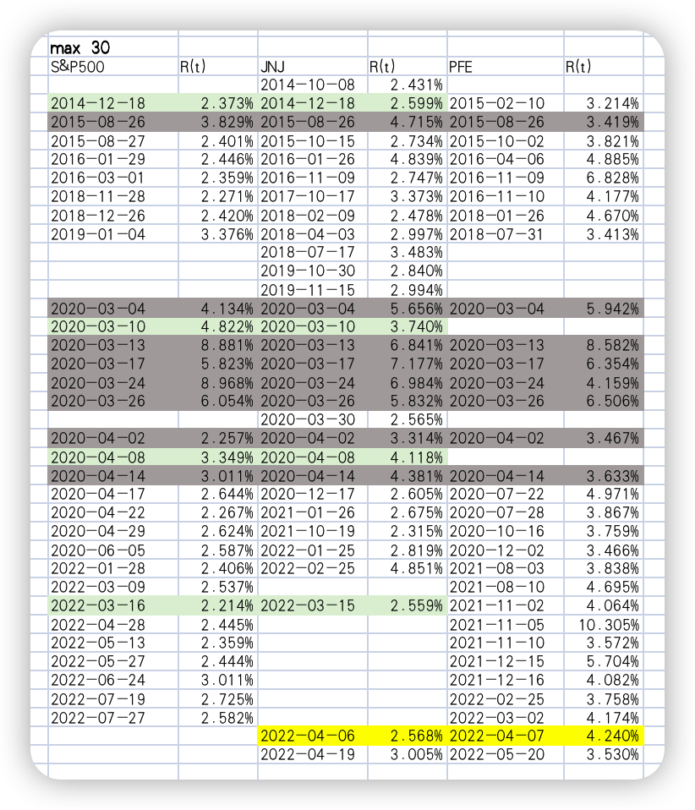
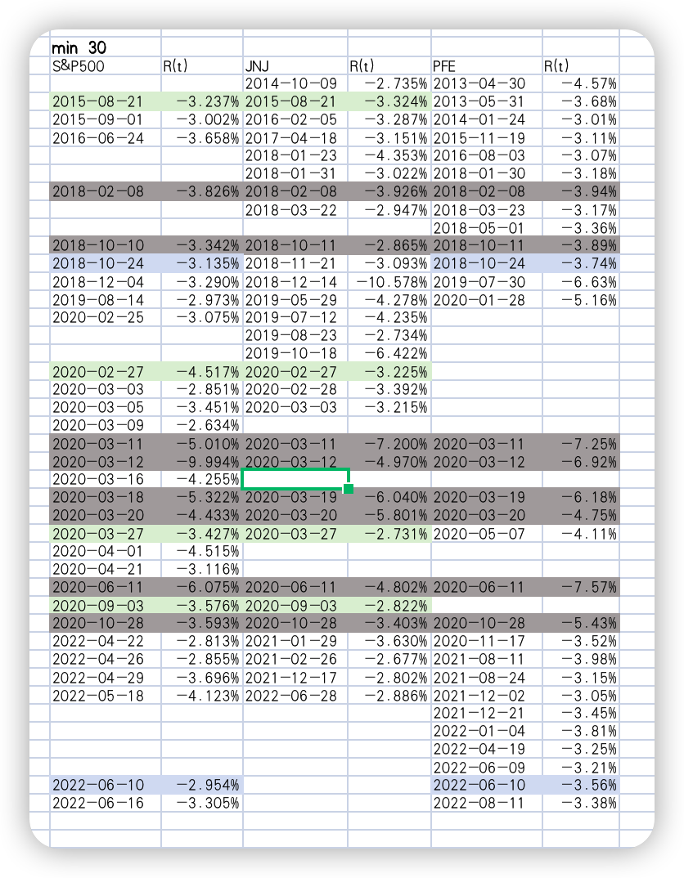
3-4 Coincidence
Many extreme
returns on the
three stocks even occurred on the
same day

Slide 32
4
Problems and Reflections

Slide 33
Problems and Reflections
Why can the ABS
return show
stronger correlation?
Why the PFE
distribution is not
negatively skewed?
For Further
Study
Why are stock
returns and
volatility negatively correlated?
We hope to relate
to the events
happened in reality to explain these
problems in further study.

Slide 34
THANK YOU
Catch the feel of design in contemporary colors and styles

